Slide 1
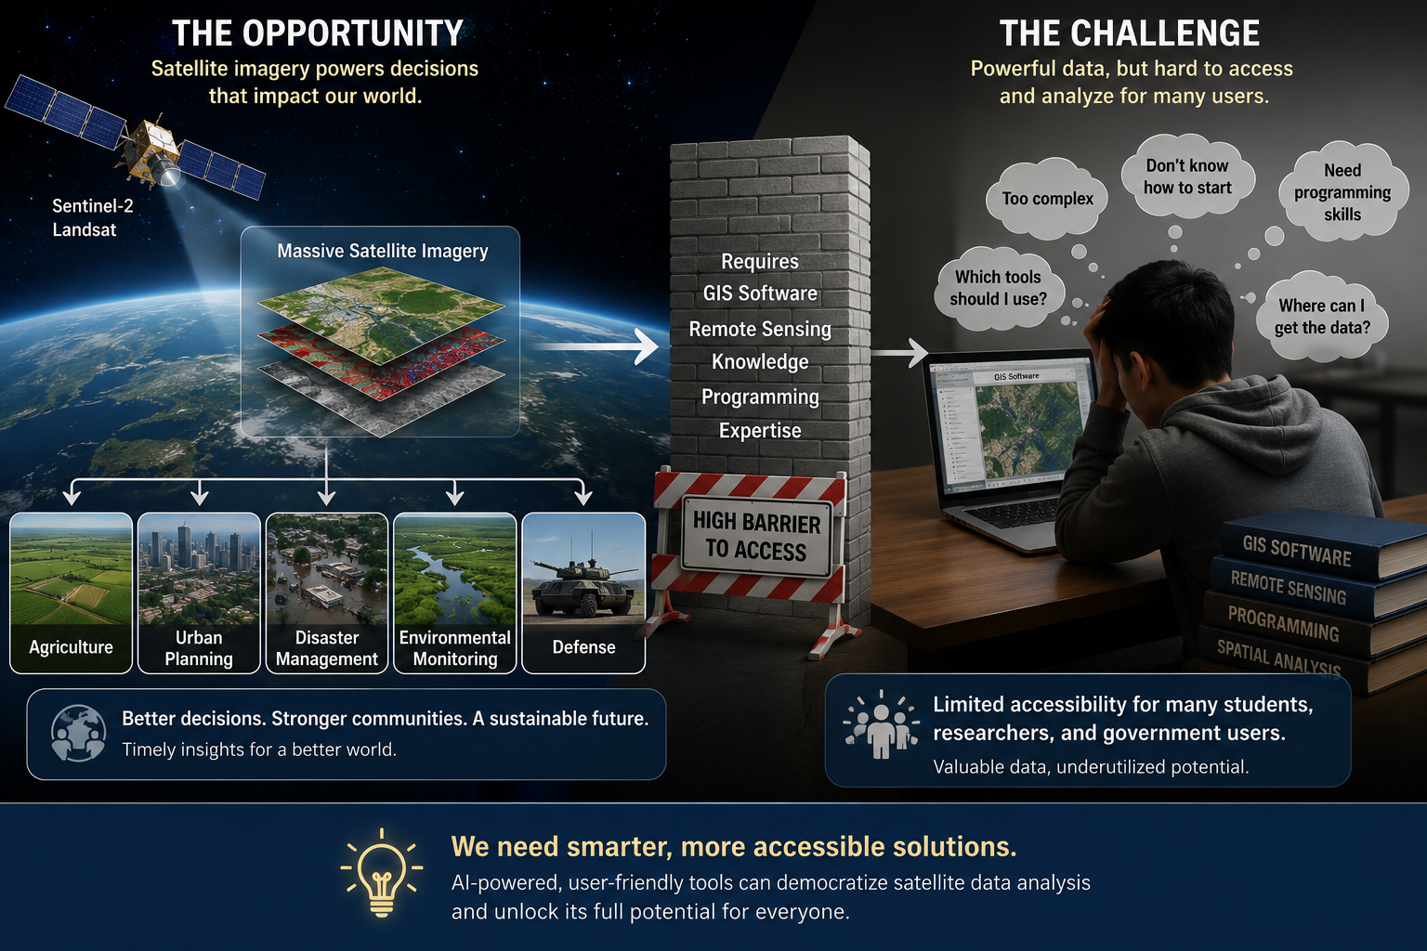
Current Situation:
Satellite imagery is extensively used in agriculture, urban planning, disaster management, environmental monitoring, and defense, generating massive Earth observation data from satellites such as Sentinel-2 and Landsat.
However, analyzing this data requires GIS software, remote sensing knowledge, and programming expertise, making geospatial analysis difficult and inaccessible for many students, researchers, government agencies, and non-GIS users.

Slide 2
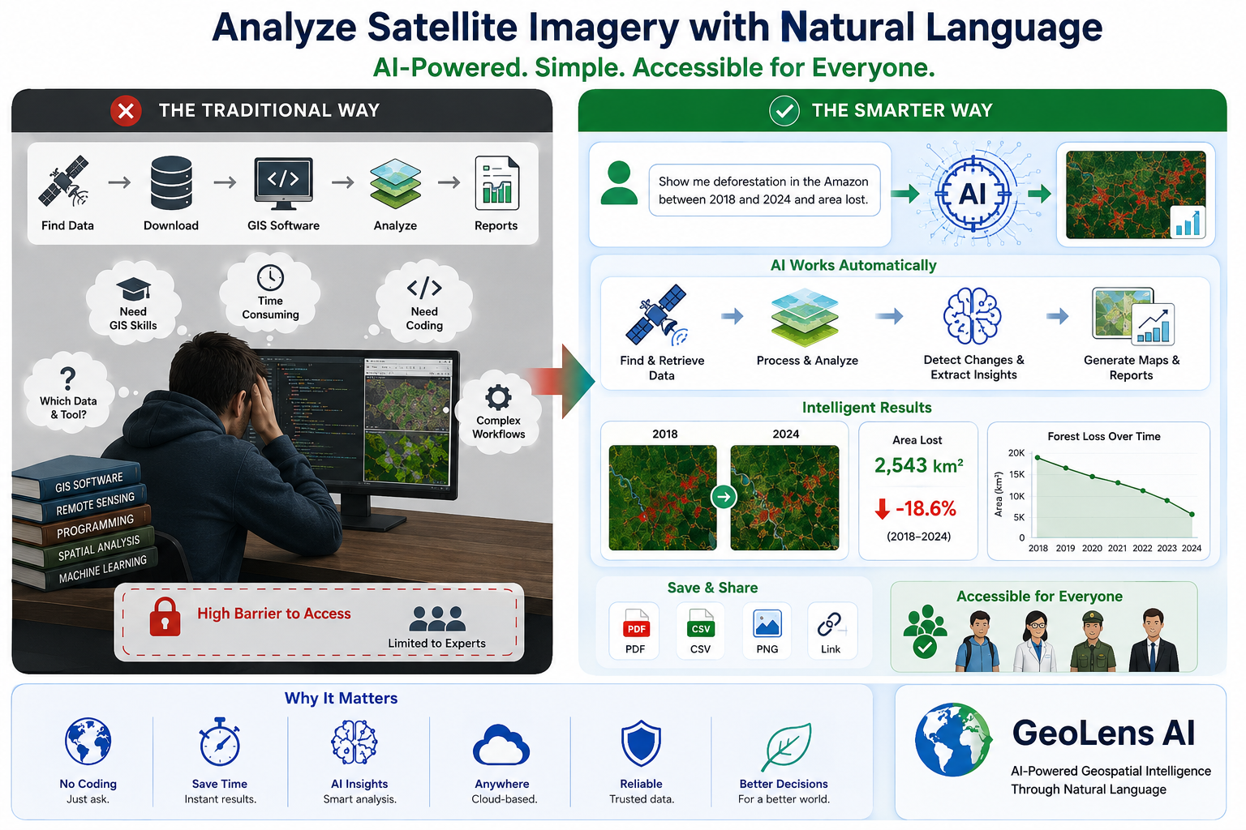
Motivation :
To Develop an AI-powered platform that enables users to analyze satellite imagery through natural language, making Earth observation and Research accessible without requiring complex GIS coding

Slide 3
Problem Statement:
Satellite imagery provides valuable information for monitoring environmental and urban changes. However, most existing geospatial analysis tools require GIS knowledge and programming skills.
The process of accessing, analyzing , and interpreting satellite data is often complex and time-consuming. As a result, many students, researchers, farmers, industries, and government organizations find it difficult to use these tools effectively.
There is a growing need for an AI-powered platform that makes satellite image analysis simple and accessible, allowing users to interact using natural language, the platform can automatically retrieve, process, analyze, and explain geospatial data without requiring complex GIS workflows.

Slide 4
Objectives & Expected Outcomes :
Develop an AI-based geospatial intelligence platform.
Automate satellite image retrieval using Google Earth Engine.
Generate accurate visualizations and intelligent reports for decision-making in environmental and urban monitoring.

Slide 5
Datasets & Requirements:
Datasets:
Software:
Sentinel-2 (ESA)
Google Earth Engine
OpenStreetMap (Current Visualization)
Future:
  Landsat-8
  MODIS
  DEM
Crew AI
React.js
Node.js
Google Earth Engine API
Vs Code
MongoDB,PostGis
Leaflet

Slide 6
References
Google Earth Engine Cloud Computing Platform for Remote Sensing Big Data Applications: A Comprehensive Review(2020)
Handbook of Geospatial Artificial Intelligence .Available: https://www.acsu.buffalo.edu/~yhu42/papers/2023_GeoAIHandbook_Preview.pdf?utm_source=chatgpt.com
Sentinel-2 User Handbook, European Space Agency.
ArcGIS Documentation.
GIScience in the Era of Artificial Intelligence: A Research Agenda.Available: https://www.tandfonline.com/doi/full/10.1080/19475683.2025.2552161?utm_source=chatgpt.com

Slide 7
THANK YOU

